Slide 1



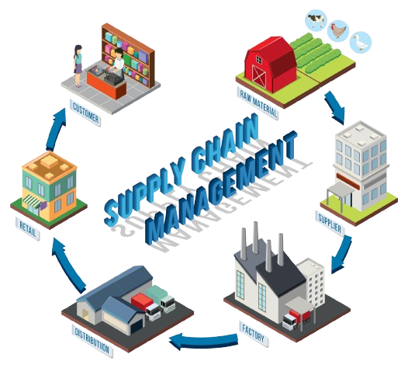

TLIQ
MART
SUPPLY CHAIN IN FMCG
AV
CREATED BY
V.ARUN KUMAR

Slide 3
TLIQ
MART
AGENDA
1
Company Details
About Atliq Mart Company Details
Problem Statement
2
Understand AtliQ Mart(Imaginary Company)challenges with on-time and in-full deliveries, on-time-in-full deliveries.
3
Project Overview
Outline the project's objectives, focus, datasets, and data corrections.
4
Insights
Analyze key findings and insights from the data exploration.
5
Dashboard Showcase
Present a visual dashboard of key performance indicators and trends.
6
Recommendations
Share actionable recommendations to improve supply chain efficiency.

Slide 4
TLIQ
MART
COMPANY DETAILS
AtliQ Mart(Imaginary Company) FMCG Manufacture
FISCAL YEAR
ATLIQ’S PRODUCTS
CATEGORY
Beverages
Food
Dairy
AM Tea 100
AM Tea 250
AM Tea 500
AM Biscuits 250
AM Biscuits 500
AM Biscuits 750
AM Butter 100,250,500
AM Curd 100,250,500
Am Ghee 100,150,250
Am Milk 100,150,250
FY_2022
SEPTEMBER(2021)-AUGUST(2022)

Slide 5

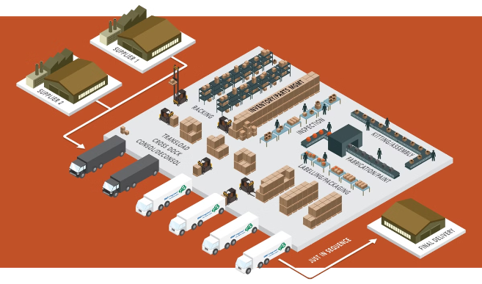
TLIQ
MART
Problem Statement
AtliQ Mart is a growing FMCG manufacturer headquartered in Gujarat, India. It is currently operational in three cities Surat, Ahmedabad and Vadodara. They want to expand to other metros/Tier 1 cities in the next 2 years.
Supply Chain Challenges
AtliQ Mart faces difficulties ensuring timely and complete order fulfillment across multiple locations.
Data-Driven Approach
The Supply Chain team is implementing a standardized approach to measure service levels using OT, IF, and OTIF metrics.
Data Analyst Role
As a Data Analyst I examine data to uncover significate insights and explore themes I will use various analytical tools to concise and Storytelling

Slide 6

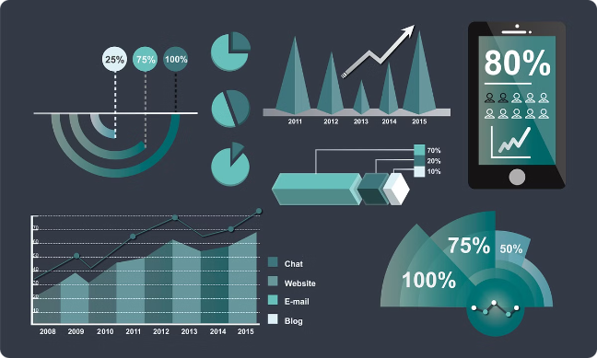
TLIQ
MART
Project Overview
1
Objective
Conduct a comprehensive analysis of customer, order, and target order datasets.
2
Focus
Analyze OT, OTIF, and IF percentages by city and product.
3
Datasets
Utilize customer, orders_aggregate, and target_orders datasets for analysis.
4
Data Corrections
Remove trailing spaces and ensure data consistency for accurate analysis.

Slide 7


INSIGHTS
The detailed insights, analyses, and observations from the data exploration. It includes metrics, trends identified during the data analysis process

Slide 8
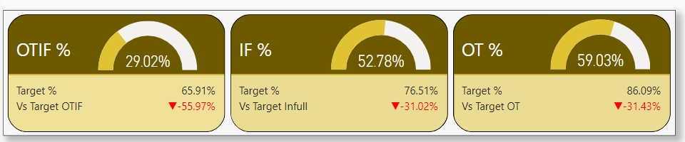
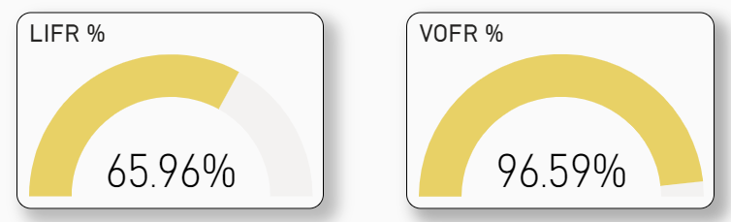
Top Level KPIs

Slide 9
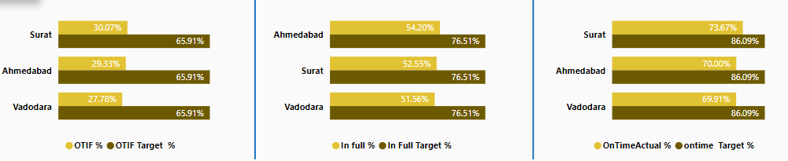
Split by Cities
Surat
Ahmedabad
Surat
Highest on-time in-full (OTIF) % (30.07%)
Highest In-full (IF)% (54.20%)
Highest on-time (OT) %(73.67%).
“Vadodara Have Lowest OTIF %, IF %, and OT % compared to other cities”.

Slide 10
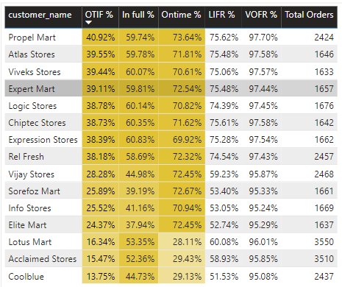



Split by Customers
Propel Mart
Highest OTIF %, IF %, and OT % among all customers, indicating excellent service
performance.
Coolblue
Lowest OTIF %, IF %, and OT % among all customers, requiring immediate
attention to improve service quality
Other Customers
Varied performance levels among other customers, suggesting further analysis
is necessary to identify specific areas for improvement.

Slide 11
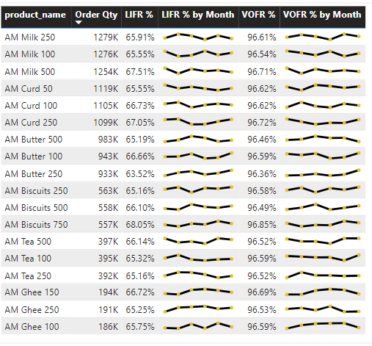



Product Insights
Top & Low-Performing Products
AM Curd 250: This product has the highest order quantity at 1279K.
AM Ghee 100: This product has the lowest order quantity at 186K.
Underperforming Products
products with low OT, IF, and OTIF rates to understand underlying challenges.
Product Trend Analysis
LIFR % and VOFR % Trends: The trend lines for both LIFR % and VOFR % show fluctuations over time for most products. Some products, like AM Milk 250 and AM Curd 100, exhibit more stability, while others show more variability.

Slide 12

Metric Performance Over Time

Slide 13
DASHBOARD
CLICK HERE FOR DASHBOARD

Slide 14




Recommendations for AtliQ Mart
Optimize Delivery Routes
Improve Inventory Management
Implement route optimization software to reduce
travel times, minimize fuel consumption,and ensure timely delivery.
Implement a robust inventory management system to
prevent stockouts and ensure sufficient product
availability to meet demand.
Enhance Communication
Train Delivery Personnel
Provide training to delivery personnel on best practices for on-time and in-full delivery, including customer service protocols.
Improve communication channels between the supply
chain team, customers, and delivery partners to ensure accurate order information and timely updates.

Slide 15
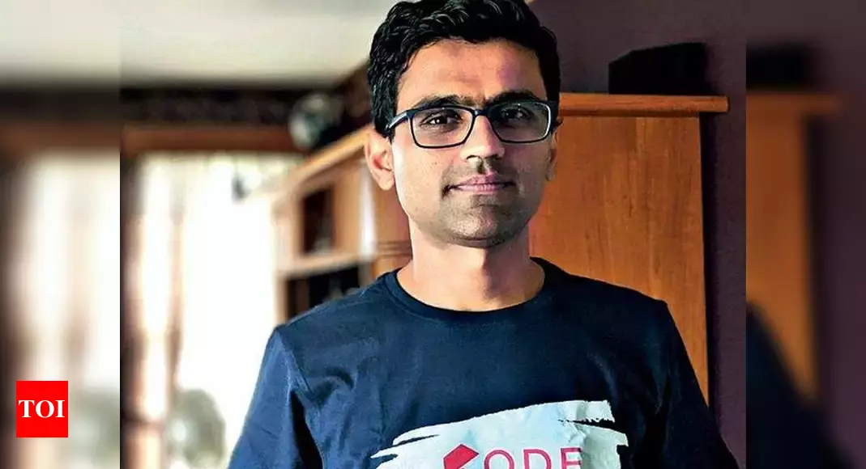

TLIQ
MART
THANKYOU
HEMANAND SIR
DHAVAL PATEL SIR

